Slide 1


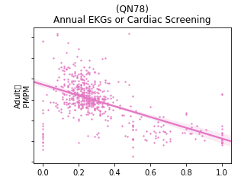
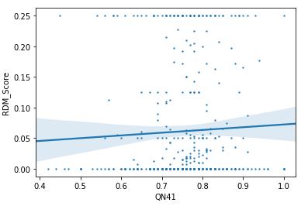

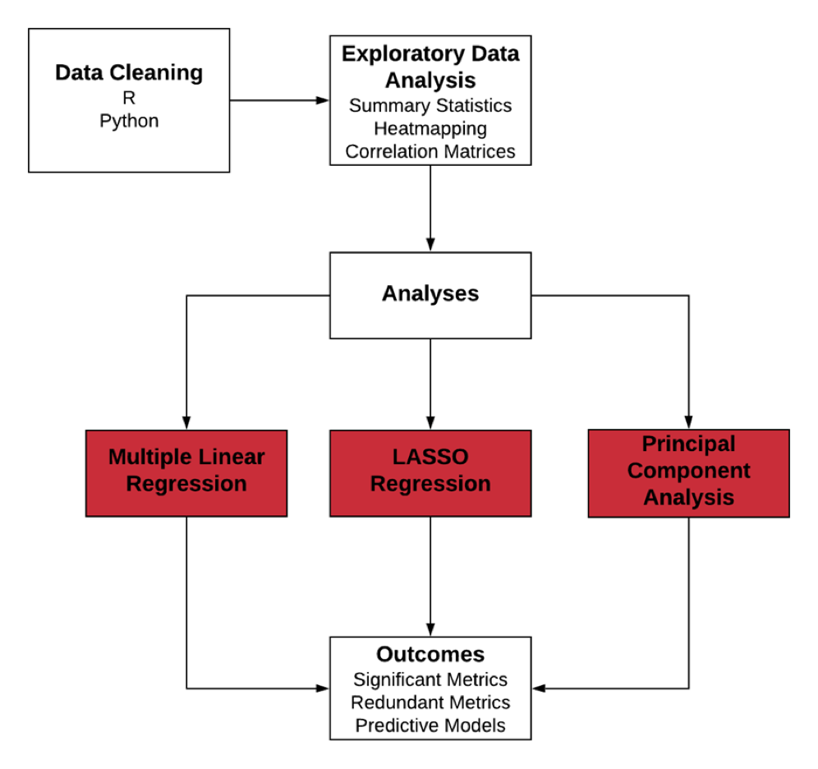
Analyzing Effectiveness of the True Performance Program
Manjiri Kshirsagar, Jeremiah Humes, Jonathan Dyer, Moe Wolf
Faculty Advisor: James F. Jordan Client Liaison: Irem Velibeyoglu
OBJECTIVES
Evaluate the effectiveness of the True Performance (TP) Program
Analyze which quality metrics in the TP program lead to lower cost outcomes
Investigate other value based reimbursement programs
Program Features:
Exploratory analysis
(QN41)
Medication Adherence for Cholesterol (Statins)
BACKGROUND
In June 2017, Highmark Inc. launched a value-based reimbursement program called the True Performance (TP) Program for Primary Care Physicians (PCP). The TP program is a pay-for-performance program in which providers get reimbursed based on certain performance measures. The program intends to reduce operational complexity and offer the potential for a significant financial value-based incentive. The aim of the program is based on IHI’s (Institute for Healthcare Improvement) “Triple Aim for Healthcare Improvement shown below:
A
B
Figure 3: A. Annual cardiac screenings are correlated with lower PMPM costs in Adults
B. Most quality metrics are not significantly associated with any of the outcomes
Multiple Linear Regression
Improve Experience of Care
PMPM Cost | ED Score | RDM Score
Avoidance of Antibiotic treatment in Adults With Acute Bronchitis | Medication Management for People With Asthma | Medication Adherence for Cholesterol (Statins)
Use of Imaging Studies for Low Back Pain (LBP) | Annual EKGs or Cardiac Screening | All-Cause Readmissions
Annual EKGs or Cardiac Screening | Colorectal Cancer Screening
Adult BMI Assessment | Comprehensive Diabetes Care: Eye Exam (retinal) performed
Medication Adherence for Cholesterol (Statins) | Use of Opioids from Multiple Providers
Improving Health of Population
Reducing Per Capita Cost of Healthcare
Reimbursement Opportunities
Reimbursement Type
Care Coordination
Lump Sum
Additional Incentives
Performance Measurement
Quality
Referral Management
Strong Medicare STARS ratings
Table 1 Quality metrics found to be statistically significant in Multiple Linear Regression
Quality
Cost & Utilization
Lasso Regression
Indicators
QA Score
Total Cost PMPM
ED Utilization
Generic Prescribing
Care Alignment
STARS Ratings
PMPM Cost | ED Score | RDM Score
Breast Cancer Screening | Annual EKGs or Cardiac Screening | Medication Adherence for Cholesterol (Statins)
Colorectal Cancer Screening |  | All-Cause Readmissions
Medication Adherence for Hypertension: renin angiotensin system antagonists
Medication Adherence for Cholesterol (Statins)
Annual EKGs or Cardiac Screening
Figure 1 High-level structure of the TP program.
This project focuses specifically on the quality component of the program. The QA score in turn is computed using around 30 quality metrics specific to each age-based population (senior, adult, pediatric).
METHODS
Based on a framework created by RAND¹ we conducted the evaluation using three approaches: Environmental Scan: Reviewed other Value Based Reimbursement (VBR) programs to evaluate the state of VBR in the United States
Table 2 Quality metrics found to be statistically significant in Lasso Regression
Expected/ Explainable Results
Stakeholder Perspectives: Conducted 2 physician interviews and spoke to subject matter experts in the area of quality metrics and payment reform
Program Features: Performed regressions to estimate which quality metrics have a statistically significant association with per member per month cost (PMPM score), Emergency Department Utilization (ED score) and readmission (RDM score).
RECOMMENDATIONS
Quality Metrics
Collect more data over time to enable better time-series analysis
Eliminate metrics that are highly correlated since they do not add value and would also help reduce physician fatigue with data entry
Program-Specific
Give more comprehensive and comprehensible feedback to the physicians on a regular basis, in order to inform physicians where they have improved and where they need to make improvements
Structure incentives based on behavioral economics³
Evaluation of the Program
Measure outcomes related to health and patient experience
Assess the causal effect of the program using a control group
Gather patient-level data in order to understand how the program is affecting patients, not just providers and payor
Figure 2 Steps in the quantitative analysis.
RESULTS
Environmental Scan:
There are mixed results regarding the success of pay for performance programs with most programs not showing an association with lower cost outcomes and better health outcomes²
Stakeholder Perspectives:
Feedback given to the physicians does not help them to make any process/ organizational changes
Physicians spend more time gathering generalized metrics than treating the patients
REFERENCES
Damberg, Cheryl L, et al. “Measuring Success in Health Care Value-Based Purchasing Programs: Findings from an Environmental Scan, Literature Review, and Expert Panel Discussions.” Rand Health Quarterly, RAND Corporation, 30 Dec. 2014
Eijkenaar, Frank, Martin Emmert, Manfred Scheppach, and Oliver Schöffski. "Effects of pay for performance in health care: a systematic review of systematic reviews." Health policy 110, no. 2-3 (2013): 115-130.
Chee, Tingyin T, et al “Current State of Value-Based Purchasing Programs.” Circulation. U.S. National Library of Medicine, May 31, 2016.

